Slide 1
School information session
Skills development through community action

Slide 2

What is the BiG Community Challenge?
Spin off from
Student lead social action project
A chance for students to make a difference in their community whilst developing employability skills

Slide 3
How to get involved

Slide 4


Step 1
Get a team together
Team up to 12 students
Aged 11-19
Student council / JLT
Alternative provisions
After school club

Slide 5



Step 2
Students to identify their “community” and what changes they want to make
  School community
  Local community

Slide 6







Step 3
What is your BiG Social Action idea?
Student led social action

Slide 7
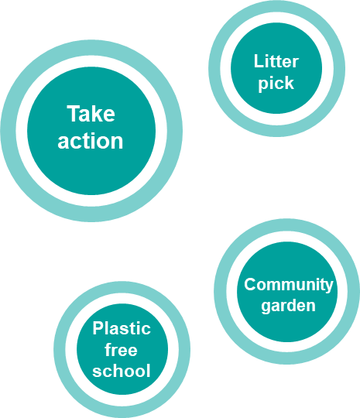


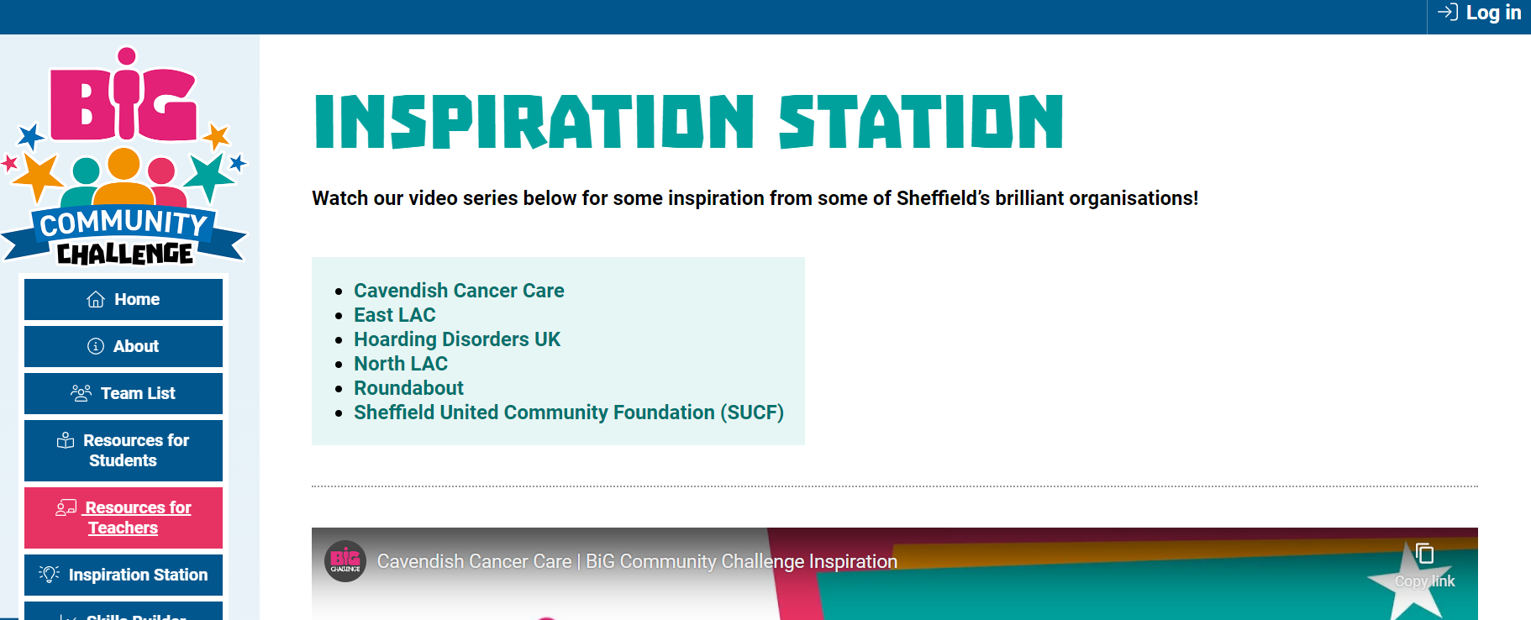
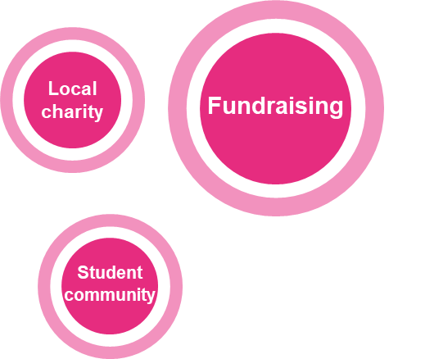
Inspiration Station
  Check out the Inspiration Station on the BiG Community Challenge website for ideas

Slide 8

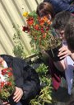
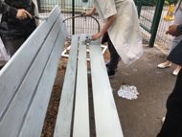
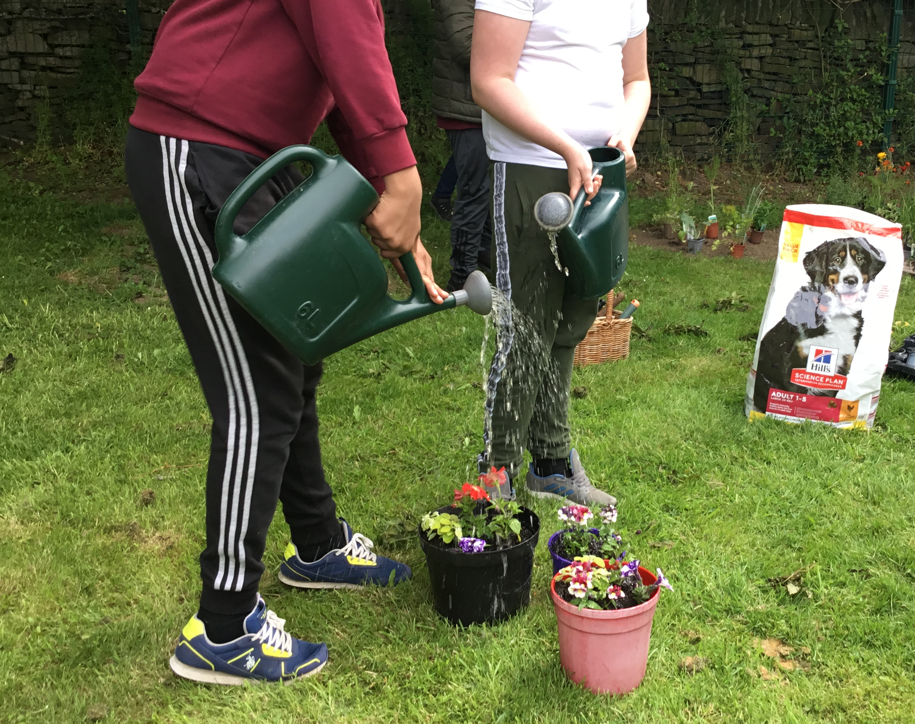

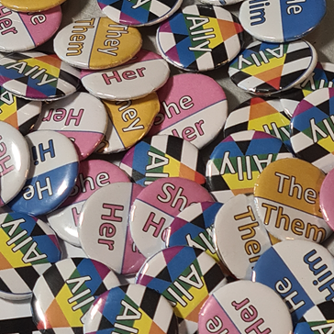

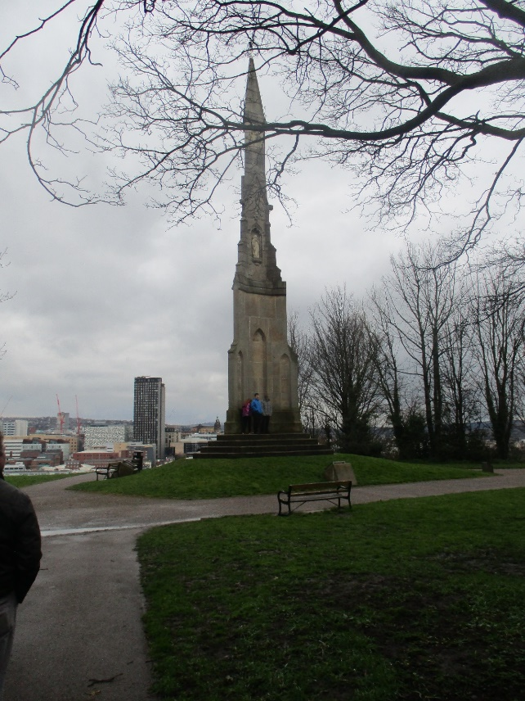
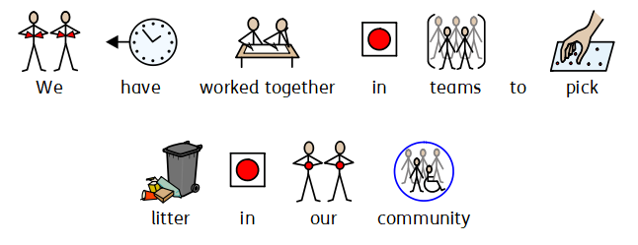
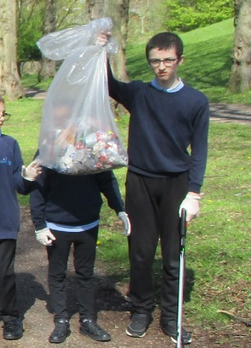
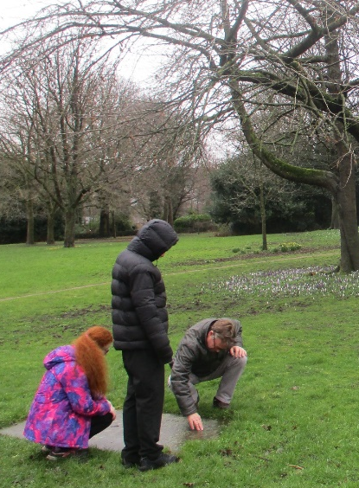
Previous Projects
Created a mindfulness garden with an upcycled bench in the school grounds to support student and staff emotional wellbeing
Made and distributed badges to raise awareness around the use of pronouns in school
Organised a number of litter picks in their local community

Slide 9


Inspiration Station
www.youth-social-action.careersandenterprise.co.uk

Slide 10

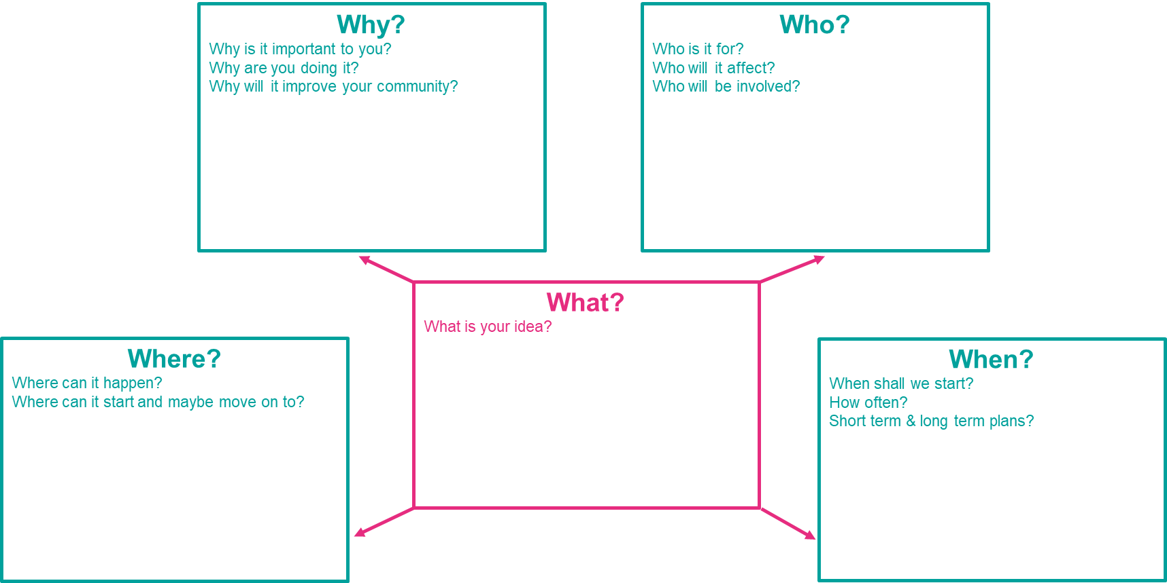
Step 4
Create a plan
Register team and plan on the BiG Community Challenge website

Slide 11

Step 5
Take action!

Slide 12





Step 6
Tell us how they got on
Reflective Journal
Short 5-minute video
PowerPoint with voice over
PowerPoint with photos and notes
Photo story book with annotation
Written journal

Slide 13

Celebration Event
Join us to showcase and celebrate the teams’ successes!
All teams that submit a Reflective Journal will be invited to join us for a celebration event at the Town Hall on Thursday 13th July.
Students will also receive a BiG Community Challenge medal and certificate.

Slide 14
The BiG Benefits

Slide 15

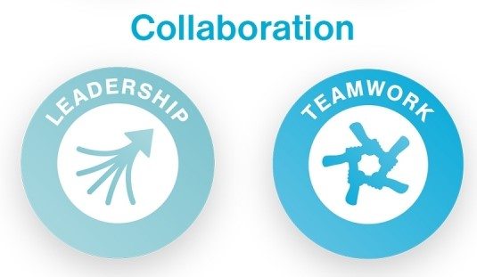



Learn and develop skills
Notes:
Benefits of the BiG Challenge:
The skills
Keep your profit
Understand how a business works
Meet real-life entrepreneurs
The chance to win different prizes

Slide 16


Student / Staff Resources
Staff and student resources provided to support each stage of the programme
Student work booklet
Paired PowerPoint slides
Reflective journal templates

Slide 17


Support and Advice
Mentor from real business to help your teams develop their ideas
£25 investment to help achieve students’ Social Action ideas

Slide 18

Make a difference
Empower your students to improve something important to them in their community

Slide 19
Role of the school lead
Lunching the project – student launch video
Recruiting the team
Support regular in-school sessions
Facilitate team to implement their BiG plan
Liaise with the BiG Community Challenge Team
Co-ordinate sessions for Team Mentors

Slide 20

Key dates
Team registration deadline: Friday 26th May
Reflective journal deadline: Friday 30th June
Celebration event: Thursday 13th July

Slide 21
Look at the
BiG Challenge website!

