Slide 1
Step 5: Take Action

Slide 2
What is aiming high?
Aiming high is the ability to set clear, tangible goals and devise a robust route to achieving them – in this case, effective planning, setting goals for yourself and your team and knowing what doing well looks like!
Skills Builder Aiming High Skills Summary Video

Slide 3
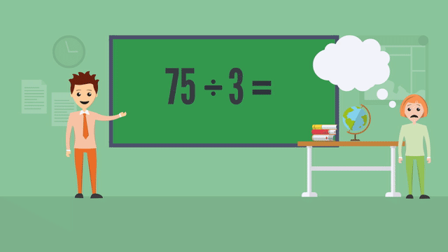
Skills Builder – Aiming High Working effectively
I work with a positive approach to new challenges
Part 1 - Why new challenges are a good opportunity
Part 2 - How to find opportunities for stretch

Slide 4
Working with a positive approach Things to consider
Why is it important to be willing to take on new challenges?
What would happen if we avoided new challenges?
When have I learnt from a new challenge before?
How can I find challenges that work for me?
What does working in my ‘stretch zone’ mean?

Slide 5
Things to think about…
Set a target
What do you want to achieve? a
Use your connections
Who do you know?
Have a clear ask
What is the issue?

Slide 6
What do I need to do?
Prepare a pitch
Understand the cause
Make it fun!
Be inclusive
You need to ‘sell’ your idea to others
You need to know why you are doing it
People will join in more if they are enjoying themselves
Think about how everyone can get involved
Different audiences may need different approaches
You need to be able to explain this to others
Fundraising can be fun!
Make information easy to access

Slide 7
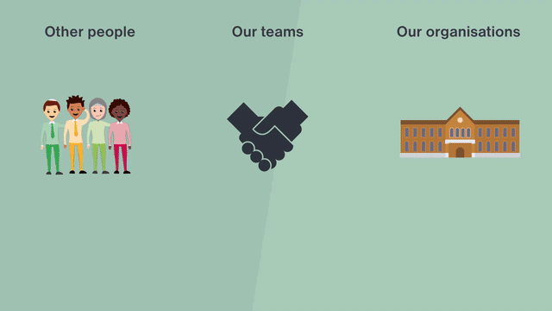
Skills Builder – Aiming High Setting goals
I set goals informed by an understanding of what is needed
Part 1 - how to identify the needs of others - individuals, teams & organisations
Part 2 - How to build these needs into goals

Slide 8
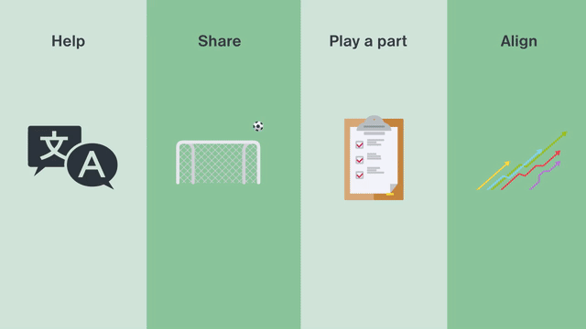
Identifying needs & setting goals Things to consider
How can you identify the needs of other people when setting goals?
How can you identify the need of an organisation or community?
How can you create goals based on the needs of others?
How can you make a contribution to bigger goals?
Can you give any examples of when you have done this?

Slide 9
Reach out!
Reach out to local community groups and neighbours
Reach out to your school community
Reach out to friends and family

Slide 10
Promote your cause
Posters
Flyers
Talking & sharing
Local paper
Online adverts

Slide 11
Say thank you!
Don’t forgot to say thank you to everyone that helps you!

