Slide 1
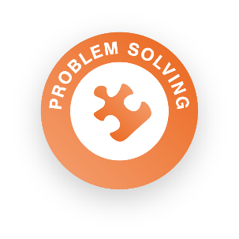
Step 4: What is your BiG Social Action plan?

Slide 2
What is problem solving?
Problem solving is about generating ideas and evaluating those options – in this case, thinking of different solutions to your problem, working with your community to find out what they want, and deciding which ideas are best
Skills Builder Problem Solving Skill Summary Video

Slide 3
Your SOCIAL ACTION plan
How to come up with a good Social ACTION plan!
What is your team passionate about?
What are your team strengths?
What problems are affecting your community that you want to help with?
How will your idea make a difference by July 2024?

Slide 4
Skills Builder – Problem Solving Finding solutions to challenges
I complete tasks by explaining problems to someone for advice if I need to
Part 1 – How to explain a problem to someone else
Part 2 - How to act on advice

Slide 5
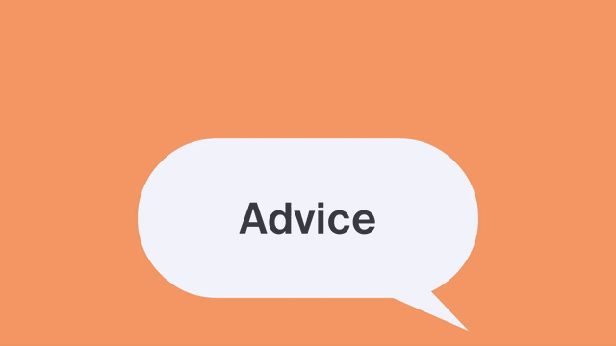
Skills Builder – Problem Solving Finding solutions to challenges
Start with a goal – what are you trying to achieve?
Who could you ask for advice?
Is there anybody already doing something similar?
What should I do and what should I avoid doing?
Have I done this before?
How did it go?

Slide 6
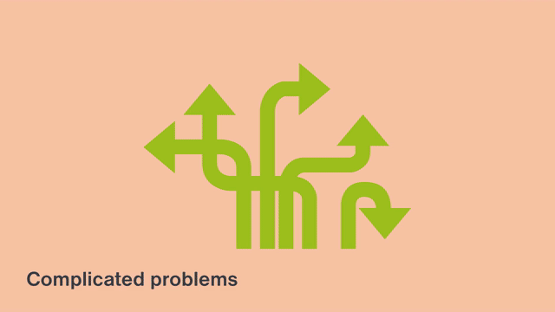
Skills Builder – Problem Solving Finding solutions to challenges
I explore problems by creating different possible solutions
Part 1 – When problems might have lots of answers
Part 2 – How to come up with multiple potential solutions for those problems

Slide 7
Skills Builder – Problem Solving Finding solutions to challenges
What problem are you trying to solve?
Think of as many different solutions to the problem as possible.
How can we come up with lots of ideas?
How do we know if an idea will make something better or not?

Slide 8
Community engagement
Community engagement is where you talk to people you think would benefit from your idea or could help you. These people could also be stakeholders.
A stakeholder is anyone who has an interest or ‘stake’ in the issue, such as those personally affected, or who work, campaign on volunteer on the issue.
Thinking about the following may help with creating your social action plan:
Who are your stakeholders?
Are they people who your idea will help? Or people who can help with your idea?
What do they think of your ideas?
Is anyone doing your idea already?

Slide 9
Have you registered?
Don’t forget to enter your team details and ideas on the:
BiG Challenge website
Deadline for entries:
19th April 2024

