Slide 1
Step 3: What is your BiG SOCIAL ACTION idea?

Slide 2
What is social action?
Social action involves people coming together to tackle an issue, support other people, or improve their local area. For the BiG Community Challenge we want you to identify issues in your community that your team are passionate about, and where you think you could make a positive difference.
Social action can be split into 3 main types of activities:
Raising awareness
Taking action
Fundraising

Slide 3
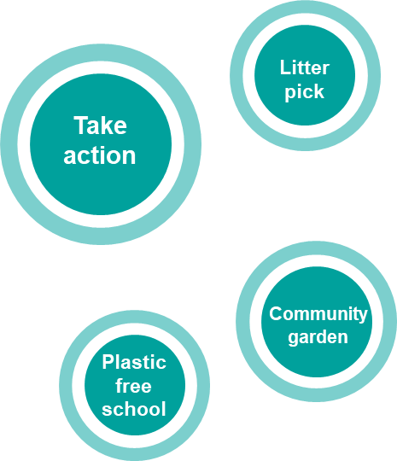
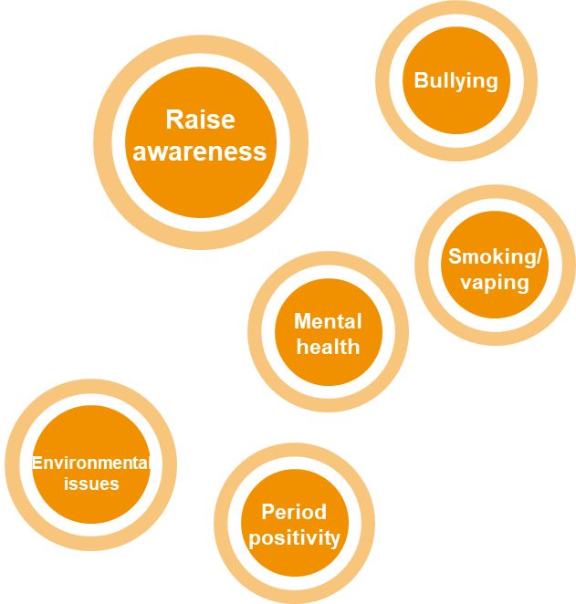
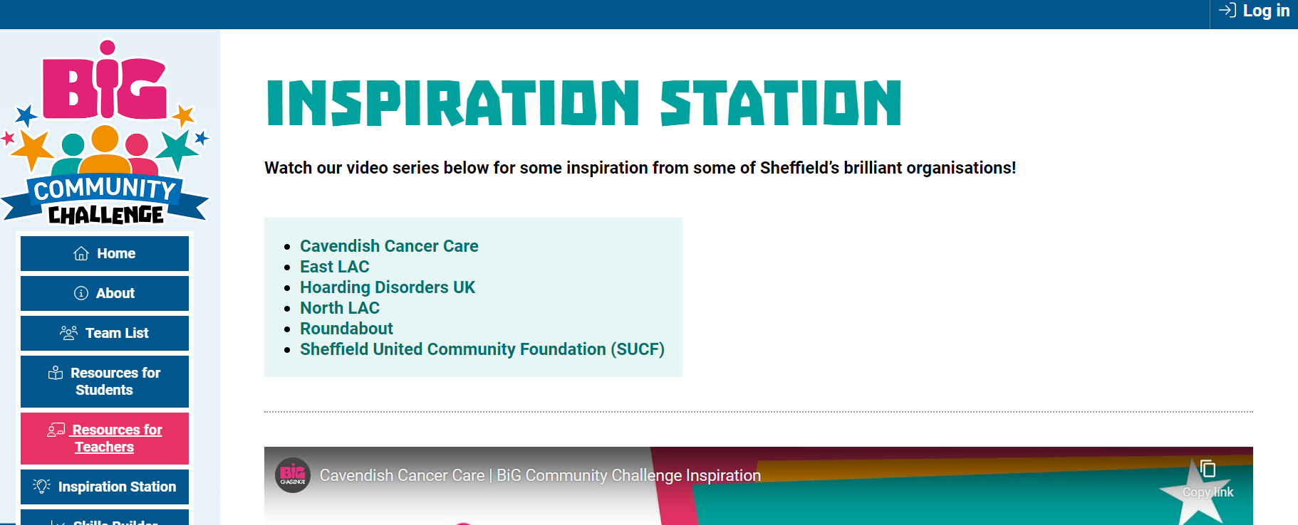
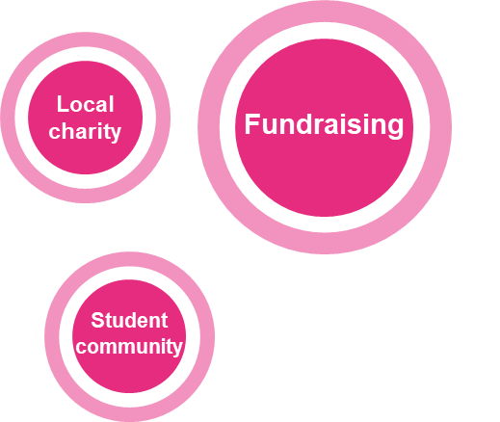
Examples of social action
Check out the Inspiration Station on the BiG Community Challenge website for ideas and case studies from previous BiG Community Challenge projects

Slide 4
What is creativity?
Creativity is the use of imagination and the generation of new ideas - in this case, coming up with new ideas for new products and services and creative ways of improving what you already have
Skills Builder Creativity Skill Summary Video

Slide 5
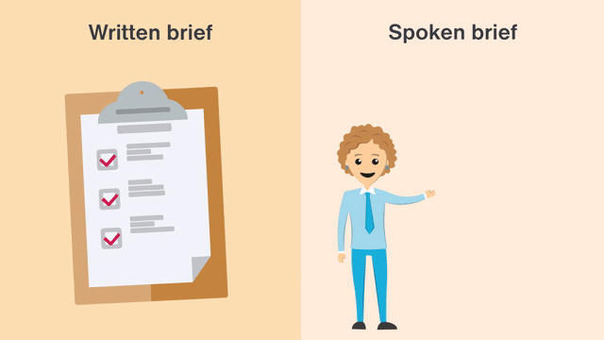
Skills Builder – Creativity Imagining and generating ideas
I generate ideas when I’ve been given a clear brief
Part 1 - What is a creative brief?
Part 2 - How to generate ideas for a brief

Slide 6
Imagining and generating ideas Things to consider
What is meant by a brief?
How can a brief be helpful?
Have I worked from a brief before?
How can I create ideas to fulfil a brief?
What should I do and what should I avoid doing?
Have I done this before?
How did it go?

Slide 7
Skills Builder – Creativity Imagining and generating ideas
I generate ideas to improve something
Part 1 - Understanding the success criteria
Part 2 - Making something better, using success criteria

Slide 8
Improving something I already have Things to consider
What are success criteria?
How can we work out what success looks like for different things?
How can we come up with lots of ideas?
How do we know if an idea will make something better or not?
Have I done this before and what was the outcome?

Slide 9
Your SOCIAL ACTION plan
How to come up with a good Social ACTION idea!
What is your team passionate about?
What are your team strengths?
What problems are affecting your community that you want to help with?
How will your idea make a difference by July 2024?

Slide 10
Have you registered?
Don’t forget to enter your team details and ideas on the:
BiG Challenge website
Deadline for entries:
19th April 2024

