Slide 1
Step 2: Choosing Your Community

Slide 2
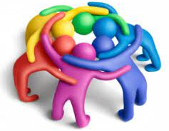
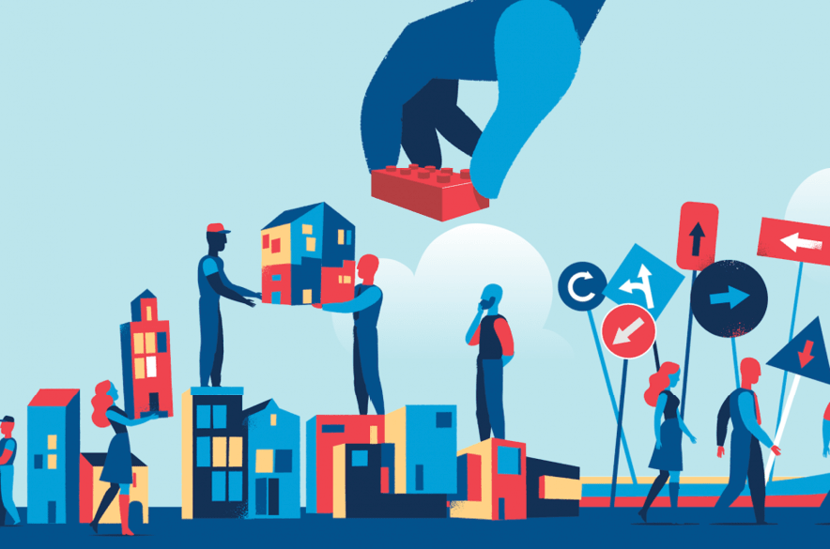
What is a Community?
A community can be made up of people living in a particular area
A community can be made up of people who have similar interests, characteristics, beliefs, or backgrounds

Slide 3
Do you want to make a difference in your local community or school?
How do you feel about your local area?
What is your favourite thing about your community?
What do you wish was different?

Slide 4
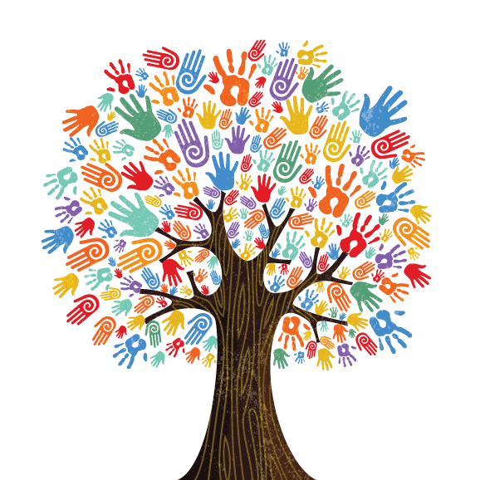
Other Community Types
A community can also be a group of people who share similar interests, characteristics, beliefs, or backgrounds
Examples:
Charities – charities are often communities of people helping to raise awareness or money for good causes
Environment – people coming together to keep places clean and tidy
Health – people raising awareness of mental health

Slide 5
What can you change in your community?
What is important to you?
What do you care about?
How can you to make a difference between now and July 2024?

