Slide 1
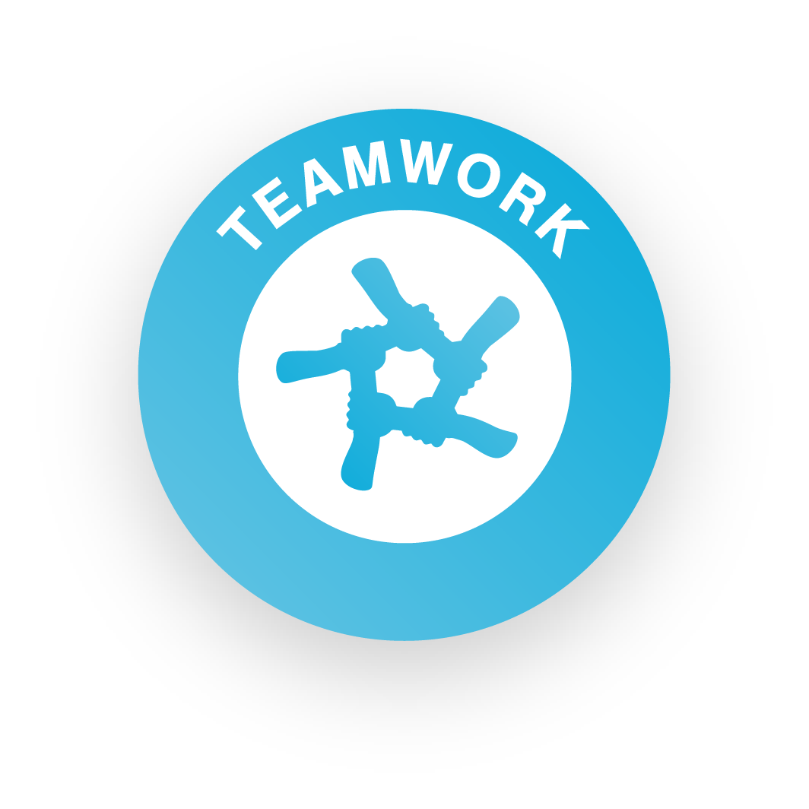
Step 1: Get your team together

Slide 2
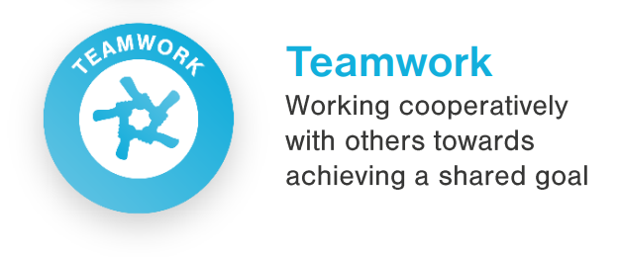
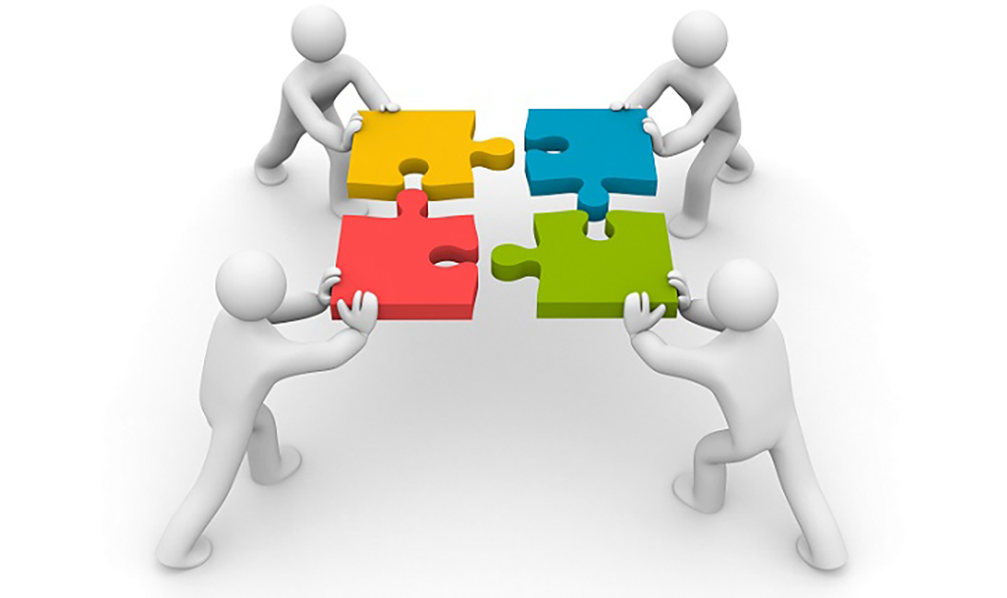
What is teamwork?
Teamwork is all about working cooperatively with others, taking responsibility and supporting each other to achieve a shared goal – in this case, developing your social action plan and making a difference!
Skills Builder Teamwork Skill Summary Video

Slide 3
Building your team
Step 1
Get your team together!

Slide 4
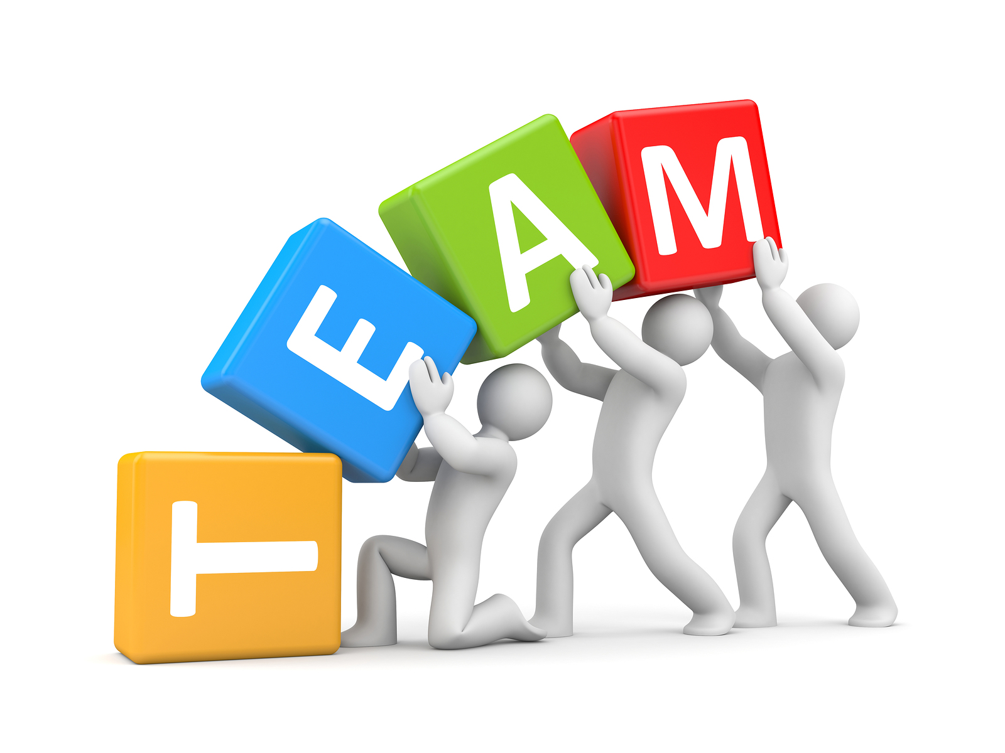
Who can be in a team?
Minimum
1 Person
Maximum
12 People

Slide 5
What’s your team name?
Does it sound professional?
Is it original?
Does it reflect your idea?
Step 2
Agree on a team name

Slide 6
Team Roles
Director
Finance
What job roles do you need in your team?
Think about each of your strengths
Marketing
Community Engagement

Slide 7
Skills Builder – Teamwork Working well with others
I work well with others by taking responsibility for completing my tasks
Part 1 - What it means to take responsibility
Part 2 - When taking responsibility works well

Slide 8
How will you work together?
Communication
Ground rules
Values
Taking responsibility
Supporting each other

Slide 9
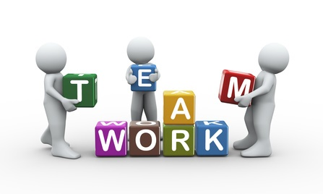
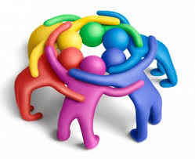
Taking responsibility Things to consider
What does it mean to take responsibility?
Why is it important to take responsibility?
How do I take responsibility?
When have I taken responsibility before?
How did it go?

Slide 10
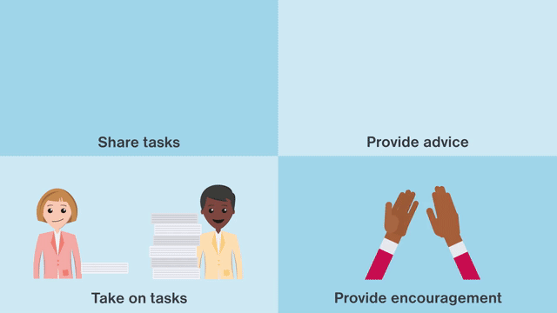
Skills Builder – Teamwork Working well with others
I work well with others by supporting them if I can do so
Part 1 - What it means to support others and why it is important and helpful
Part 2 - How to know if you can support with something

Slide 11
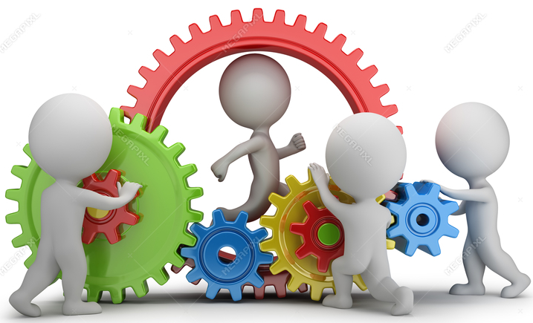
Supporting each other Things to consider
What does it mean to support others?
How can I do this?
Why is it important?
When should I not try to support someone else?
When have I supported someone before?
How did this go?

