Slide 1
Information Session for Schools
The BiG Challenge Team

Slide 2
BiG Challenge - A quick overview!
The Big Challenge (Years 7-9) aims to ignite entrepreneurial spirit through a city-wide competition that connects young people and employers through an immersive enterprise experience.
Students are loaned £25 start-up funding by their school and supported by Business Advisers, resources, and employer supported workshops to develop an idea to test in the market over the festive season, reflecting on their experience as the programme completes in February.

Slide 3
In short….
It’s a competition to make as much money as possible!
Sheffield programme, for Sheffield schools, delivered by the See It Be It in Sheffield Team
Opportunity for insight into the real world of work
Employer encounters
Gatsby Benchmark 2, 4, 5 and 6
Personal and individual skills development
Running in Sheffield for 16 years

Slide 4
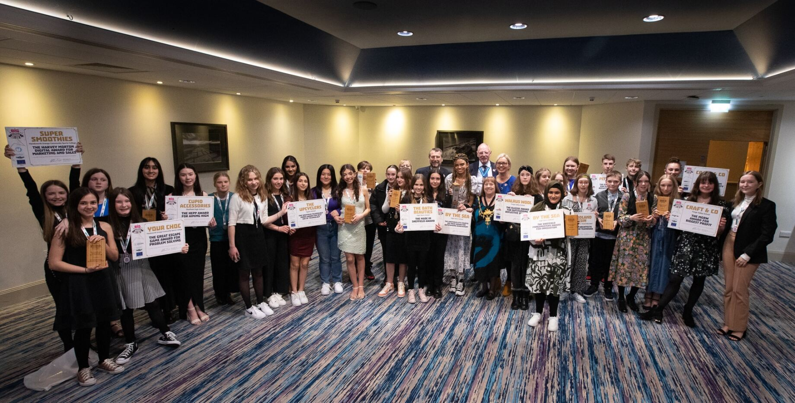
BiG Challenge 2023
Last year in numbers…
188 teams entered
20 schools entered teams
762 students took part
47 reflective journals submitted
This year we want to make it even BiGGer!

Slide 5
Skills Builder – 8 essential skills needed to succeed

Slide 6
Our BiG Challenge Skills Focus
Step 3: I work well with others by taking responsibility for completing my tasks
Step 4: I work well with others by supporting them if I can do so
Step 3: I generate ideas when I’ve been given a clear brief
Step 4: I generate ideas to improve something
Step 1: I know what doing well looks like for me
Step 4: I work with a positive approach to new challenges
Step 2: I complete tasks by explaining problems to someone for advice if I need it
Step 4: I explore problems by creating different possible solutions

Slide 7
School lead - What do you need to do?
Introduce the BiG Challenge to your Y7 - Y9 students
Show the launch video https://www.youtube.com/watch?v=zAsVUATwmLc
Hold a BiG Challenge meeting for students who are interested in entering
Register your teams on the BiG Challenge website
Registration opens 9th October

Slide 8
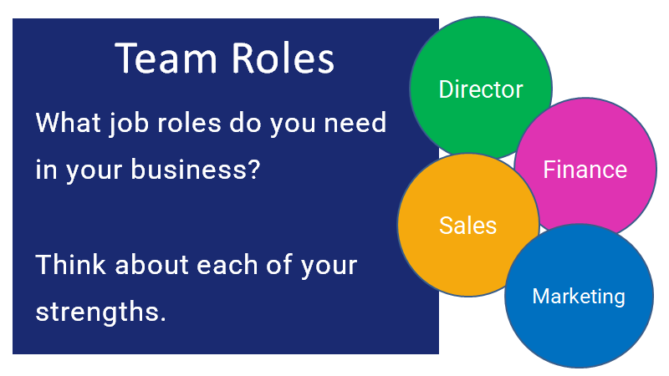
What support will school leads get?
The BiG Challenge Team including your Enterprise Coordinator
Website: Being revamped and updated for 2024 with a bespoke login for each school, managed by your BiG Challenge School Lead
Resources: guidance and support readily available – student workbook to lead you and students through the process, top tips, how to…, skills videos, teacher resource pack
Dedicated email address for all queries, questions or updates –
bigchallenge@sheffield.gov.uk

Slide 9
What support will the teams get?
Business Advisers
Face to face or virtual meetings on a fortnightly basis
Advice and guidance on all aspects of business development
New Student Workbook
Help lead teams through the process
Login to the BiG Challenge website
Blog posts, register for selling opportunities
Selling opportunities
Moor Market, Orchard Square

Slide 10
The role of Business Advisers
Linked with a specific school
Face to face or virtual meetings on a fortnightly basis
Flexible and to be arranged with the school lead
Offer advice and guidance on all aspects of business development
Topics to be led by students and school lead
Safeguarding:
DBS:
If you already have DBS – take into school
If not – once you’ve had engagement with school lead we will carry out a DBS check
The safeguarding of students participating in BiG Challenge activities within the school setting, is the responsibility of the school BiG Challenge Lead.

Slide 11
How do we measure impact?
Business success?
Can easily be measured in monetary terms
How much money have they made?
Did their product sell well?
Profit
Personal development measures?
Skills Builder Benchmark

Slide 12
Resources to support skills–Skills Builder
Step by step online guides, advice and videos to support building each skills step.
Examples of Skills Builder resources:
Teamwork - Step 3
Teamwork Step 3 - Skills Builder Universal Framework
Linked video resources for each step of the skills ladder
Teamwork Step 3 Part 1 - What it means to take responsibility

Slide 13
Competition Awards
Interim award (Nov)
Marketing
Final Awards
Teamwork
Aiming High
Creativity
Problem Solving
Sale & Marketing
Innovation
Sponsored by local employers, organisations and businesses.
Celebration & Awards Event
21st March 2024
Use of Technology
Made in Sheffield
Sustainability
Outstanding Journal
Biggest profit
Big Prize

Slide 14
Save the date! 21st March 2024 BiG Challenge Celebration & Award Evening OEC Sheffield

Slide 15
Thank you for joining us! Any Questions?
Contact email
bigchallenge@sheffield.gov.uk

