Slide 1

Promote and sell your product!

Slide 2

What is Aiming High?
Aiming high is the ability to set clear, tangible goals and devise a robust route to achieving them – in this case, effective planning, setting goals for yourself and your business and knowing what doing well looks like!
Skills Builder Aiming High Skill Summary Video

Slide 3
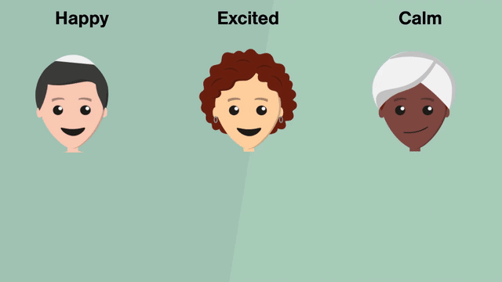
Skills Builder – Aiming High
Working effectively
I know what doing well looks like for me
Part 1 - How to recognise good work
Part 2 - How to know when you are making a useful contribution

Slide 4
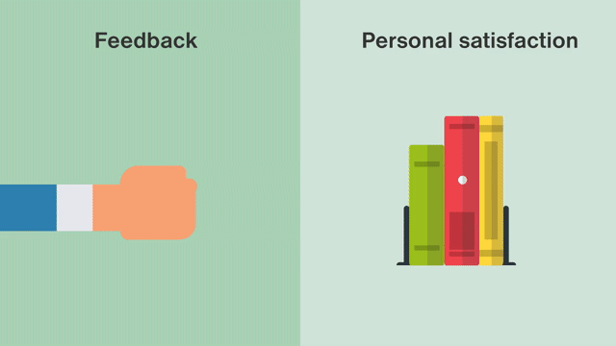
Knowing what good looks like for me
Things to consider
How do I know when I have done good work?
How does it feel when I have done something well?
What else might doing well mean?
When have I done this before?

Slide 5

Business brand identity
Brand identity is about how you want your customers to see your business
What do you want them to think and feel about your business?
What kind of message do you want to send? For example: Professional, friendly, home made, creative, fun, environmentally friendly
What is your logo?
What colours will you use? (Some colours can have different meanings, for example, green can suggest eco-friendly, red can be associated with danger)
How will you describe your product/service and what font will you use?
Don’t forget your unique selling point!

Slide 6

Marketing
Telling people about your business
Now you have your brand identity, you can use this to help make your packaging and marketing materials.
Here are some ways to promote your product or service:
Advertising – posters, flyers, adverts in newsletters
Selling events – stalls at school, local craft fairs
Online – remember that there are age restrictions on some sites so you might need help from someone else
Publicity events – how about a flash dance or wearing fancy dress to get attention and hand out some leaflets?

Slide 7

Doing the maths – making a profit
What do you need to think about?
A: Product selling price
How much are you selling your product or service for?
Will people pay that amount?
B: Product cost
How much does it cost you to make your item?
A – B = Profit

Slide 8
Sell, sell, sell!

Slide 9
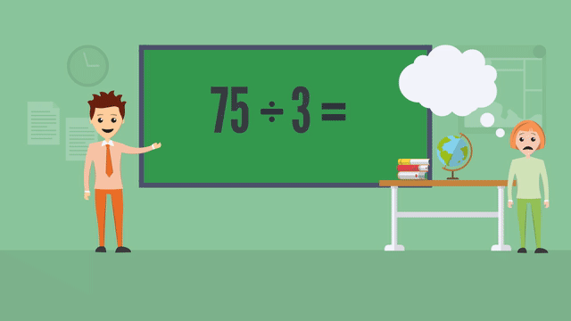
Skills Builder – Aiming High
Working effectively
I work with a positive approach to new challenges
Part 1 - Why new challenges are a good opportunity
Part 2 - How to find opportunities for stretch

Slide 10

Working with a positive approach
Things to consider
Why is it important to be willing to take on new challenges?
What would happen if we avoided new challenges?
When have I learnt from a new challenge before?
How can I find challenges that work for me?
What does working in my ‘stretch zone’ mean?

Slide 11
Budgets and finance
Keep an eye on your money!
Keeping a record of the money you spend (expenditure) and the money you make (income) will help to make sure you do not run out of funds!
Use the Cash Flow Template on the website to keep a record.
We will ask for this at the end of the competition to see how much profit you have made

Slide 12

Don’t forget…
You get to keep the profit!
….and there’s a prize at the end of the competition for the BIGGEST PROFIT!
There’s also a prize for Aiming High!
  so Aim High
  try new things
  try your best
  and make changes where things don’t work out as planned
See you at the finals!

