Slide 1
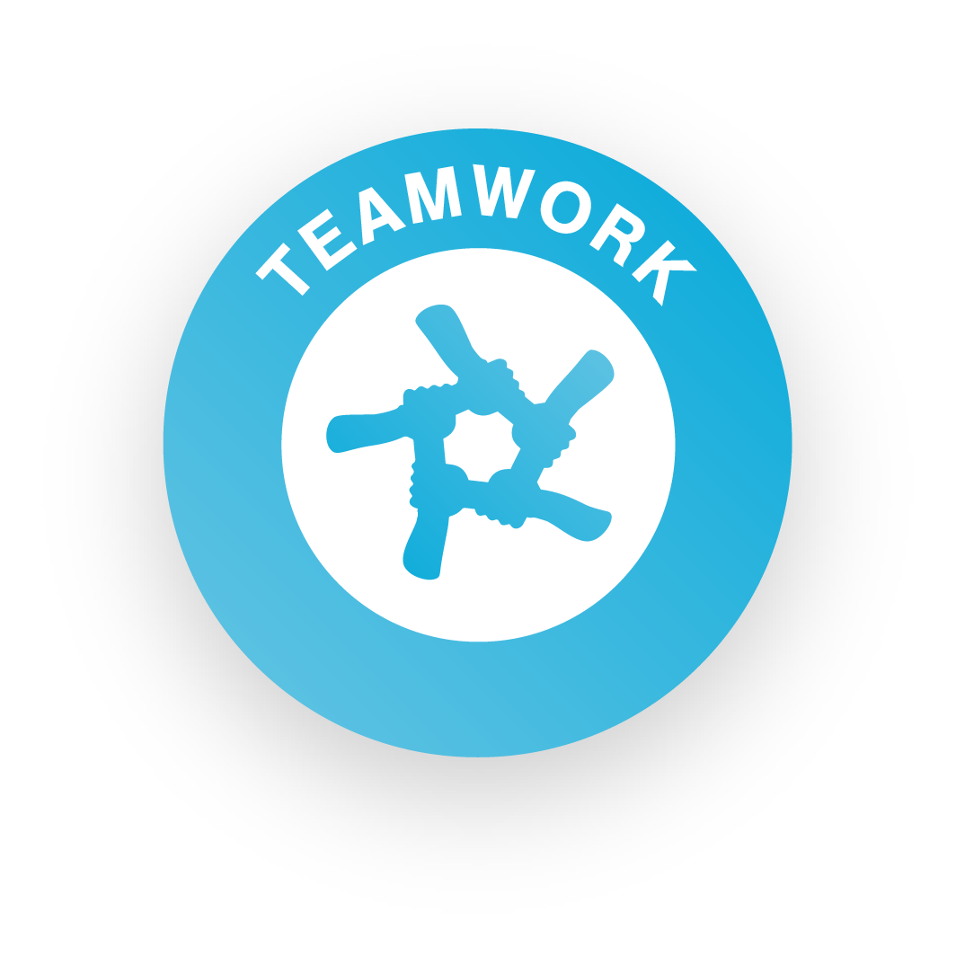
Get your team together!

Slide 2
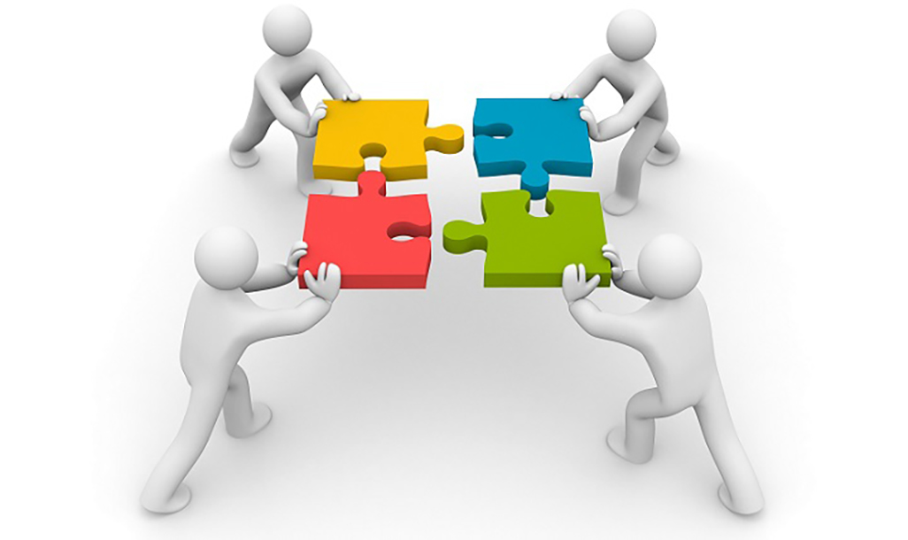
What is teamwork?
Teamwork is all about working cooperatively with others, taking responsibility and supporting each other to achieve a shared goal – in this case, creating and selling your products and making a profit!
Skills Builder Teamwork Skill Summary Video

Slide 3

Building your team
Get your team together!

Slide 4


Who can be in a team?
Minimum
1 Person
Maximum
6 People

Slide 5

Team Roles
Director
Finance
What job roles do you need in your business?
Think about each of your strengths
Sales & marketing
Production

Slide 6
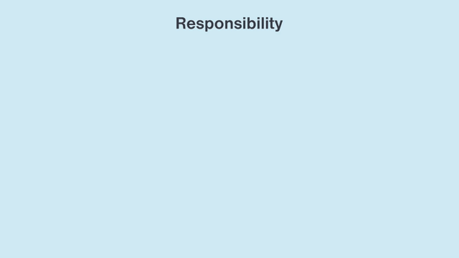
Skills Builder – Teamwork
Working well with others
I work well with others by taking responsibility for completing my tasks
Part 1 - What it means to take responsibility
Part 2 - When taking responsibility works well

Slide 7

How will you work together?
Communication
Ground rules
Values
Taking responsibility
Supporting each other

Slide 8
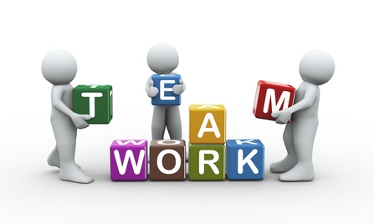
Taking responsibility
Things to consider
What does it mean to take responsibility?
Why is it important to take responsibility?
How do I take responsibility?
When have I taken responsibility before?
How did it go?

Slide 9
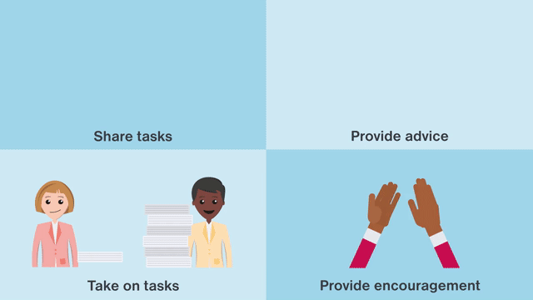
Skills Builder – Teamwork
Working well with others
I work well with others by supporting them if I can do so
Part 1 - What it means to support others and why it is important and helpful
Part 2 - How to know if you can support with something

Slide 10
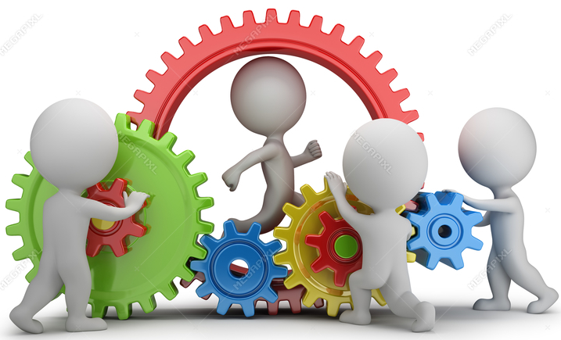
Supporting each other
Things to consider
What does it mean to support others?
How can I do this?
Why is it important?
When should I not try to support someone else?
When have I supported someone before?
How did this go?

